Slide 1

Introduction to API Testing
Graduation project presentation iti
March 2024
Waleed Abd Elnasser Bahr

Slide 2
GUI
IoT
Java
Tibco
Kafka
.NET
BPMS
API
JSON
Rules engine
XML
SOAP
WCF
Fix / Swift
JMS
Web Services
OpenAPI
ETL
Integration
Logistics

Slide 3
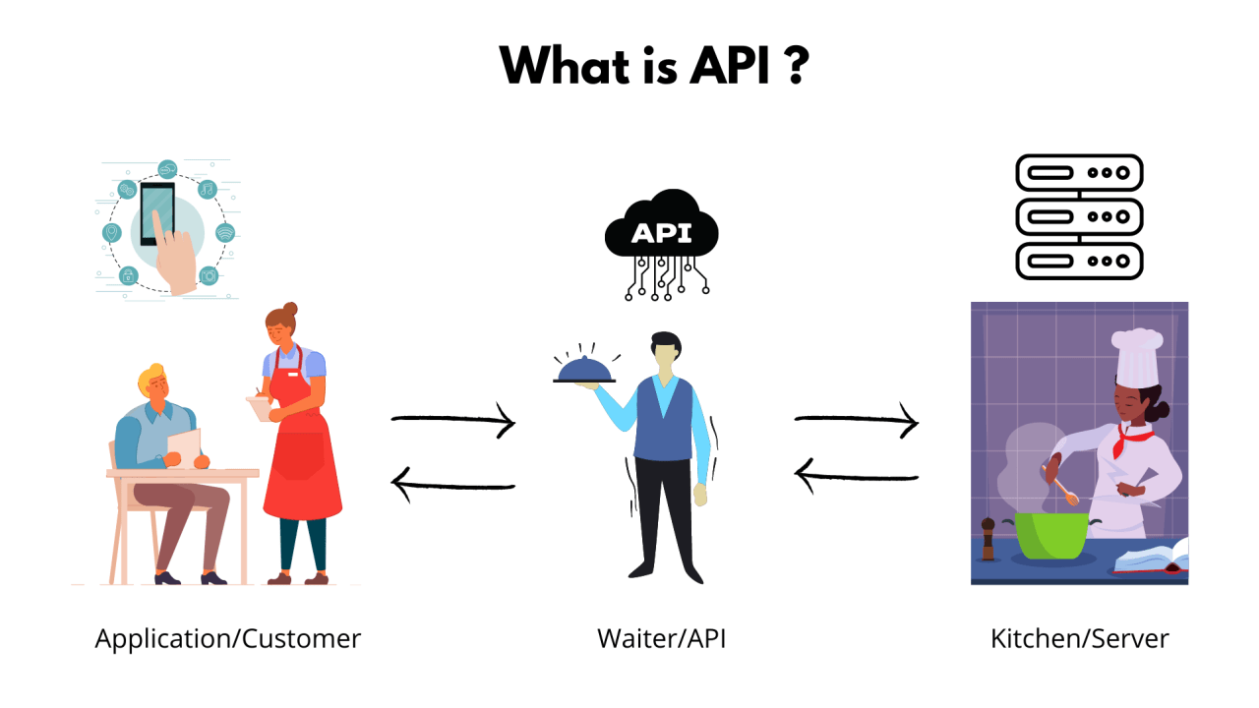
What is an API? API ( Application Program Interface ) that allows two applications to talk to each other. Example:

Slide 4
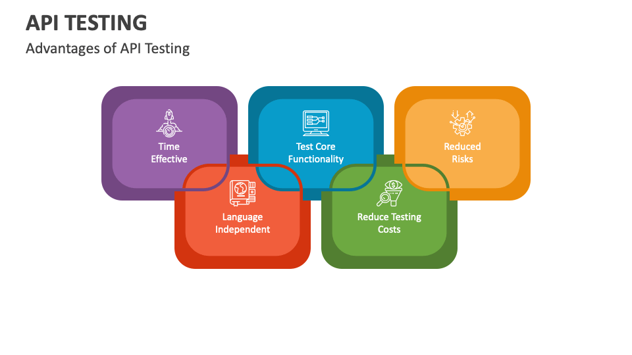

Slide 5
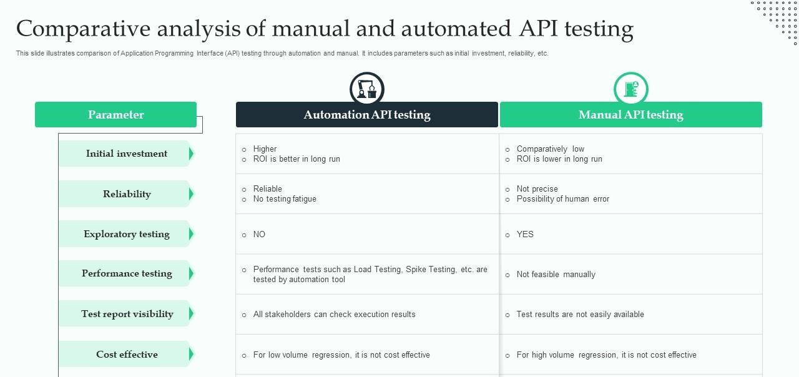

Slide 6
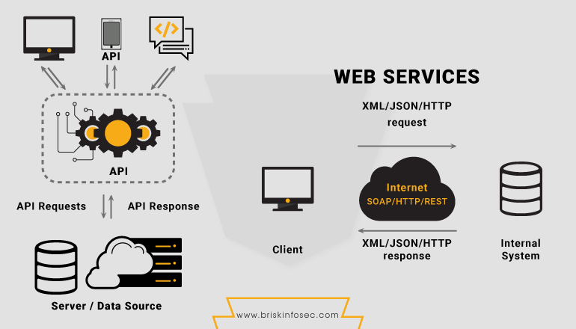
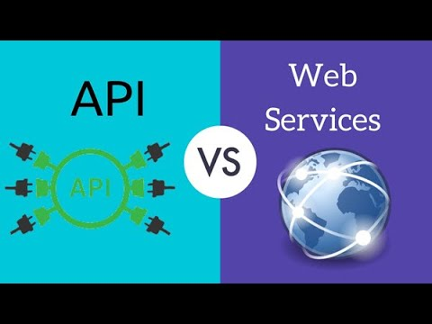
What Is The Difference Between Web Services and APIs

Slide 7
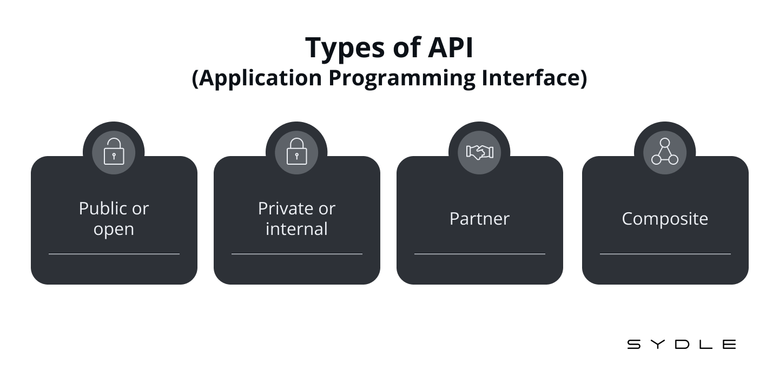

Slide 8
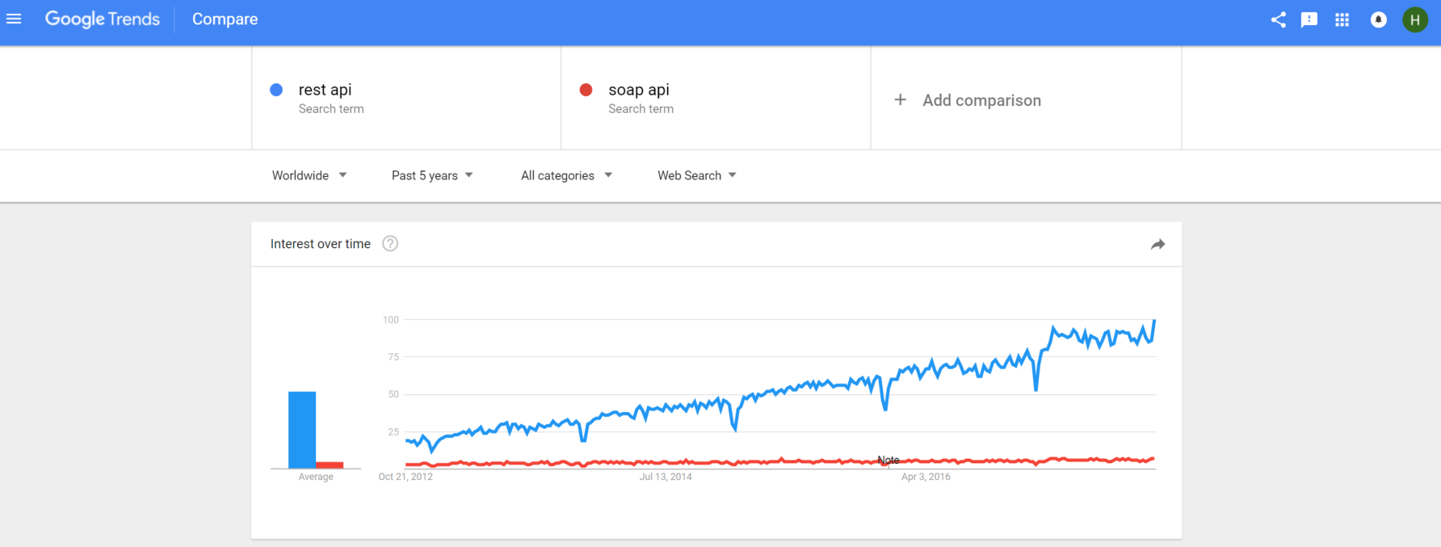
REST and Soap Layer Protocols

Slide 9

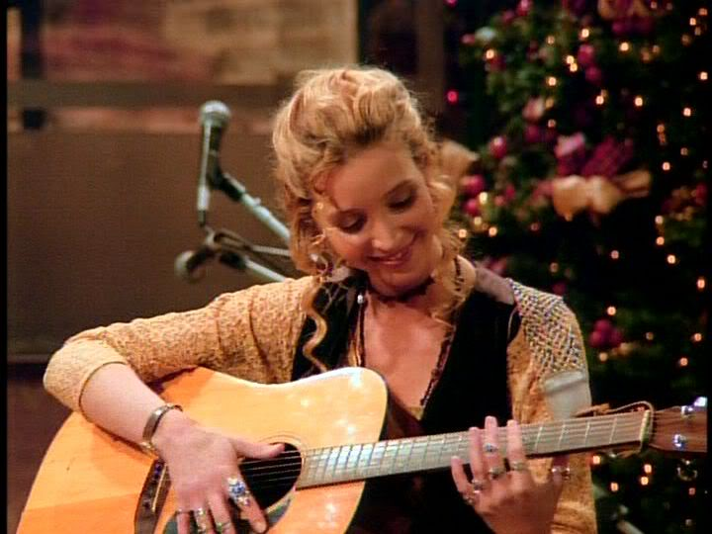

Why REST APIs ?
Easy to build
Easy to use
Fast

Slide 10
What is HTTP Verb ?
HTTP Verb tells the server about what kind of action client wants to perform.
These are the Verb we can use in HTTP request
GET —Read Request a resource
POST — Create a resource
PUT — Update a resource
PATCH — Update Partial a resource
DELETE — Delete a resource

Slide 11
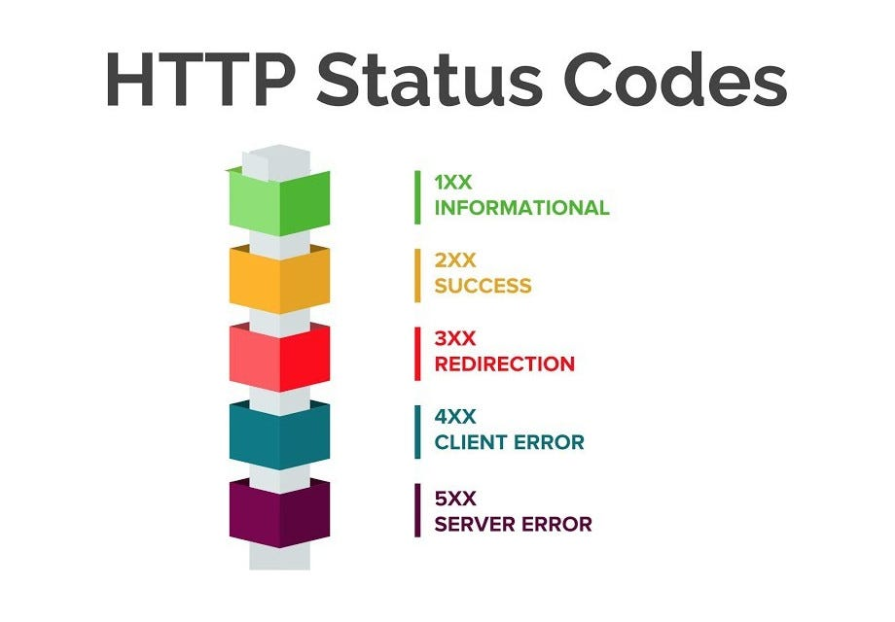
What is Status code ?
Status code states the whether your HTTP request has been successfully completed .
Response codes are grouped as follows:
100–199 — Informational message
200–299 — Successful message
300–399 — Redirection message
400–499 — Client side error message( means you are sending incorrect request)
500–599 — Server side error message

Slide 12
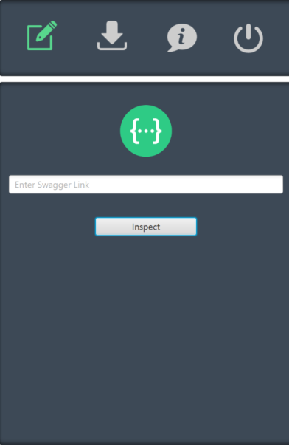

Testing REST APIs (the automated way!)

Slide 13








Testing REST APIs

Slide 14
Thanks

